Slide 2


Manish Ranglani
Cloud Manager, Datamatics Global Service Limited
manishranglani

Slide 3
Automation Appetite
Manish Ranglani

Slide 4
Agenda
What is Azure Automation?
Process Automation
Update Management
Configuration Management
Common Use Cases and Integration Scenarios

Slide 5
Azure Automation
There are mainly 3 areas Automation in Cloud Operation
Deploy and manage - Deliver repeatable and consistent infrastructure as code
Response - Event-based automation to diagnose and resolve issues
Orchestrate - Orchestrate and integrate automation with other Azure or third party services and products
Management of Azure and Non-Azure environment
Automation gives complete control during deployment, operations

Slide 6
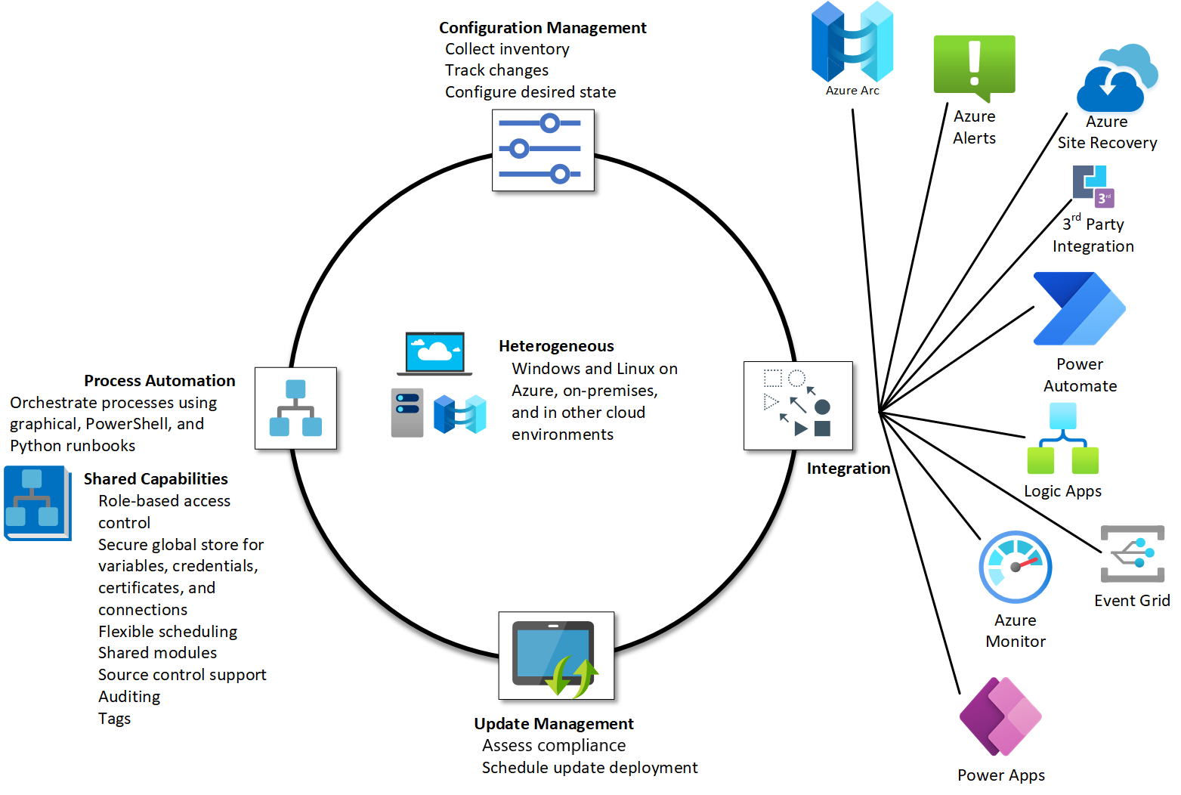
Azure Automation

Slide 7
Process Automation
Allows to automate frequent, time-consuming, and error-prone management tasks
Webhooks help to automate and schedule activities
Execute Long running scripts
Integrate with Azure Logic app and Azure Function
Lower your operational costs

Slide 8
Process Automation
Common Use Cases
Build and Deploy resources like VM
Start and Stop VM runtimes
Delete empty Resource Groups
Clear Front-Door Cache
Hybrid Automation e.g. SharePoint
Monitoring and Integrating Alerts
DB Management – Truncate Log file
Night Data Load

Slide 9
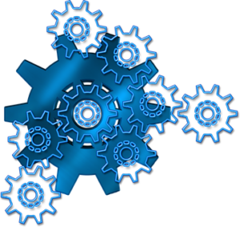
Configuration Management
Allow to track Linux and Windows virtual machine and server infrastructure changes
Tracks changes in virtual machines hosted in Azure, on-premises, and other cloud environments to help you pinpoint operational and environmental issues
It includes
Windows software
Linux software (packages)
Windows and Linux files
Windows registry keys
Windows services
Linux daemons

Slide 10
Demo 1: Create Runbook to Schedule Runtime
Virtual Machine, Containers, Kubernetes

Slide 11
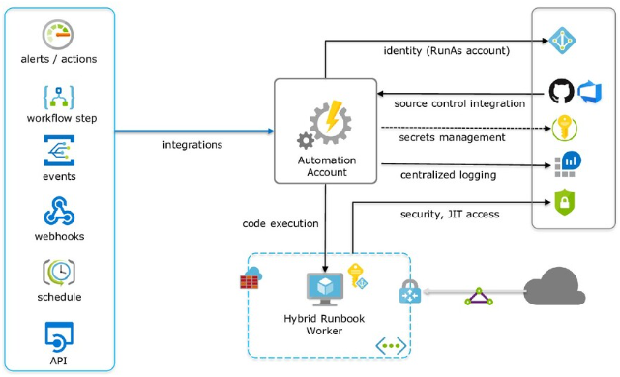
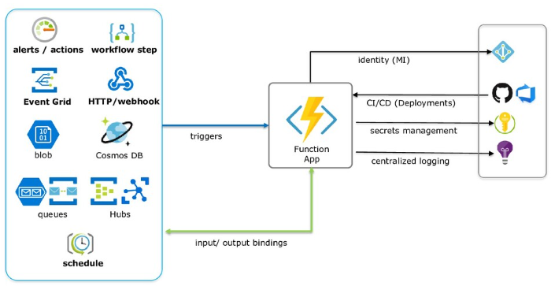
Automation Runbooks vs Function App
Runbook | Function App
Schedule long running backend tasks | Small task Processing (10 min)
No Plan upgrade | Basic, Standard, Premium Plan
PowerShell, Python | Runtime - .NET, Nodejs, Python, Java, PowerShell Core
Hybrid Run | Local Run

Slide 12
Update Management
Update/ Patching servers is critical to ensure that IT infrastructure remains secure
Orchestrate the installation of updates within a defined maintenance window
Get visibility of update compliance across Azure, on-premises, and other clouds
Include / Exclude VMs from Update Management as per need

Slide 13
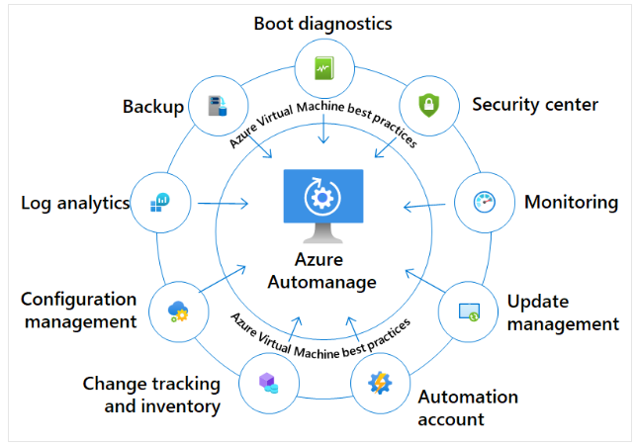
Azure Automanage
Intelligently onboard virtual machines to select best practices Azure services
Automatically configures each service per Azure best practices
Supports customization of best practice services
Monitors for drift and auto corrects

Slide 14
Demo 2: Setup Update Management and Automanage
Virtual Machine

Slide 15
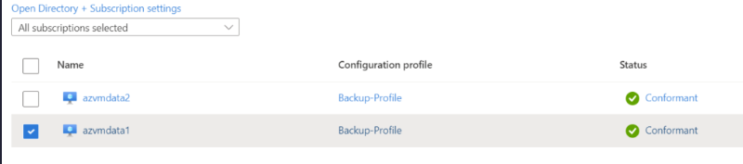
Azure Automanage Screenshot

Slide 16
Automation Benefits
Minimal upfront investment in software or infrastructure
PAYG pricing
Possibly Global deployment is at the click of a mouse
SaaS in nature
Ability to execute runbooks on premise and keep data within your data center.

Slide 17

Platinum Partner

Slide 19
Automation Appetite
Manish Ranglani

